Slide 1



Solar magnetic fields:
diagnostics and applications
^{A. Asensio Ramos}
Instituto de Astrofísica de Canarias
aasensio.github.io/blog
@aasensior
github.com/aasensio

Slide 2
Solar magnetic fields:
diagnostics and applications
Lecture 4
Non-linear inversion
Maximum-likelihood simple solution
Weak-field
More complicated cases using response functions
Levenberg-Marquardt
Milne-Eddington solution
Local thermodynamic equilibrium
Non-local thermodynamic equilibrium
Database search
New methods

Slide 3
Modern
Inference (post 80’s)

Slide 4

How to do the fitting?
The (parameterized) atmosphere is modified iteratively until a good
fit is obtained in the Stokes parameters
Using the standard least-squares solution, we want to minimize the
merit function that measures the distance between the
observed Stokes parameters and the synthetic ones
Synthesis
Observations
Noise

Slide 5

The weak-field regime
Linear relation between Stokes V and the derivative of I wrt wavelength
Do a standard linear fit
EXAMPLE

Slide 6






Biases
In the weak-field regime, one can analytically maximize the likelihood
and obtain the component of the field along the line-of-sight and
on the perpendicular plane

Slide 7
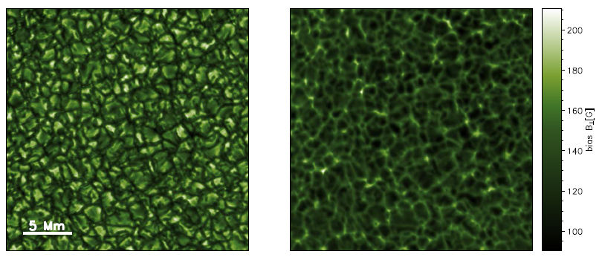
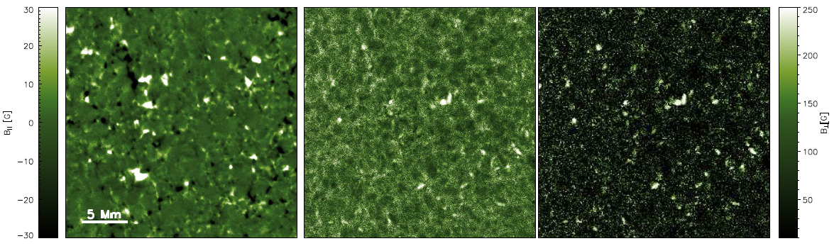
Biases – How to correct from them
Martínez González et al. (2012)

Slide 8


The non-linear optimization – Gradient descent
Gradient descent
Convergence is linear:
Too slow if close to the minimum
Can easily get stuck on local minima

Slide 9

The non-linear optimization – Newton methods
Newton method
Convergence is quadratic:
Faster if close to the minimum
Less easy to get stuck on local minima

Slide 10

The non-linear optimization – Newton methods
Computing the inverse of the Hessian is usually hard and unstable
It is usually better to solve the following system and carry out the
correction
Even in this case, the linear system can be ill-determined and
one should regularize somehow

Slide 11
The non-linear optimization – Levenberg-Marquardt method
λ large → gradient descent
λ small → Newton method

Slide 12

The non-linear optimization – Error bars
The inverse of the Hessian matrix at the optimum equals
the covariance matrix
The covariance matrix represents the variance and covariance
between all the model parameters
Error bars can be obtained with

Slide 13
The non-linear optimization – Levenberg-Marquardt method
Pseudo-code
Synthesize profiles
Compute gradient of χ²
Compute Hessian matrix H
Solve linear system
Carry out singular value decomposition
Regularize the system by setting to zero small singular values
Modify solution
Go to 1 until convergence
Compute error bars

Slide 14


The Levenberg-Marquardt algorithm in a non-linear case
The Stokes parameters at a
new value of the parameters is
where

Slide 15

Linearizing the algorithm
We assume that the χ² at the new position is close to the
minimum. We find this position by setting the derivative equal to
zero and solving for δ
Solve for δ in the linear system →
Levenberg introduced a damping that shifts from a purely
Gauss-Newton method (λ<<1) to a conjugate
gradient method (λ>>1)

Slide 16
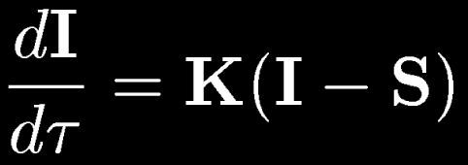
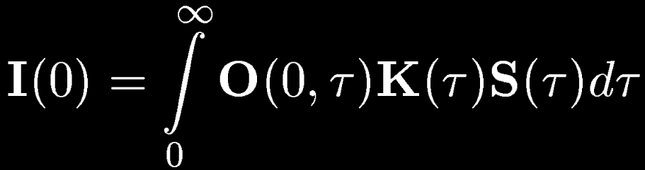
Variation along the line-of-sight (LTE)
When the physical quantities (T, B, etc.) change with height we have
to solve the RT equation to obtain the emergent Stokes parameters
In LTE, the source function is known and depends on local properties
The linear differential equation has the following formal solution
Landi degl’Innocenti & Landolfi (2004)

Slide 17
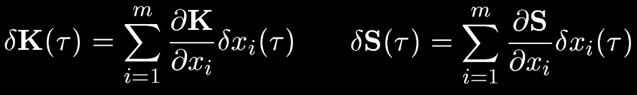
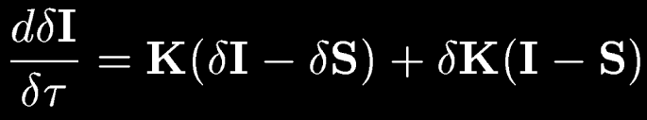
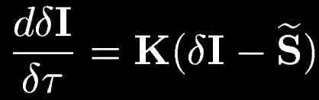
Inversion is more complicated
To do an inversion (Stokes → physical properties), we need to understand
how the Stokes parameters change when a physical quantity is perturbed
At first order:
Which is formally
equivalent to the RT
equation

Slide 18
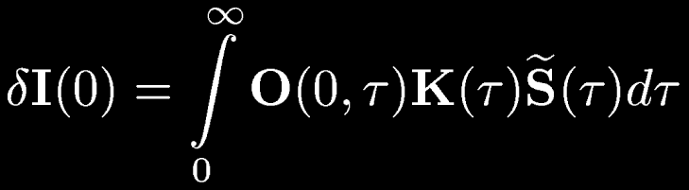

Response functions are the key
The perturbation on the Stokes parameter is given by
Which allows us to define the response function in the integral form
In local thermodynamical equilibrium, it can be computed as

Slide 19
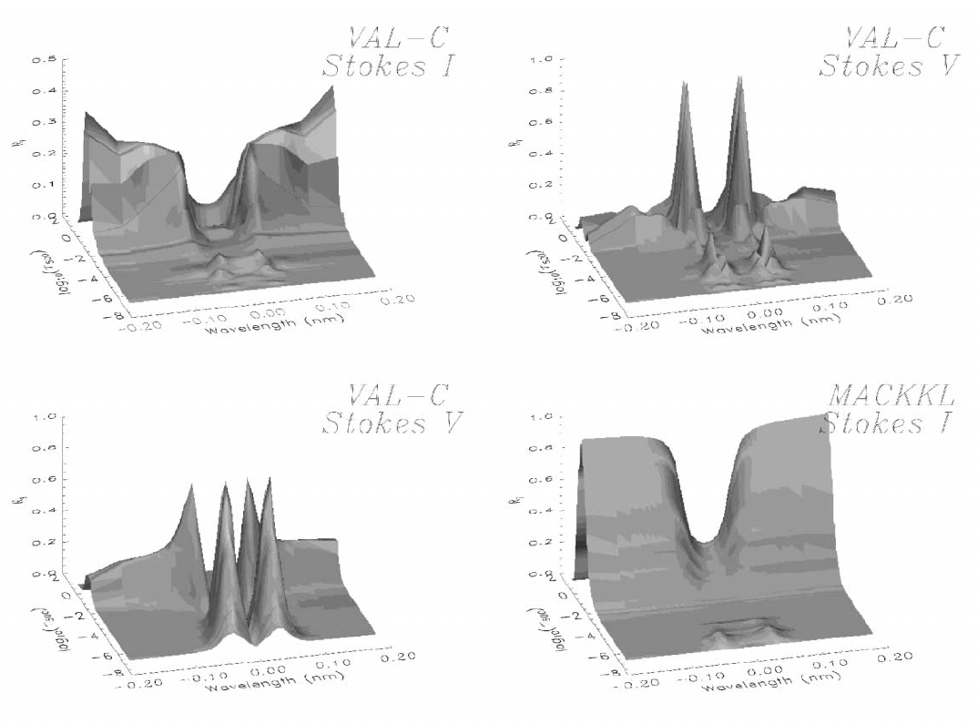
Response functions
Socas-Navarro & Uitenbroek (2004)

Slide 20
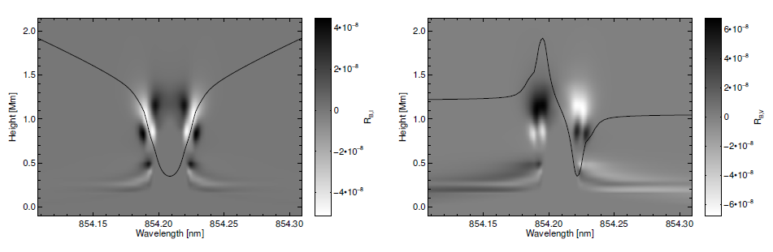
Response functions
Ca II 8542 A - Response to B
Uitenbroek (2006)

Slide 21
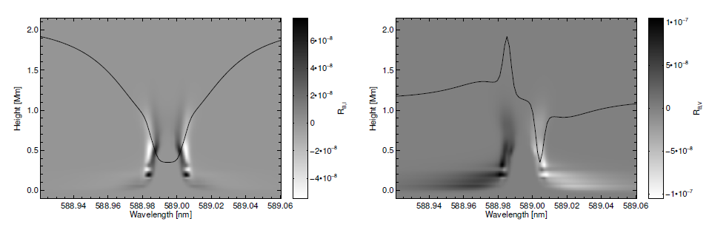
Response functions
Na I D₂ - Response to B
Uitenbroek (2006)

Slide 22
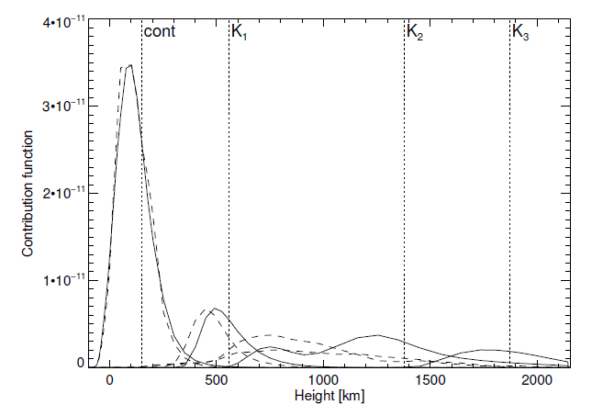
Response functions vs. height of formation
Uitenbroek (2006)

Slide 23
No gradients along the line-of-sight
Milne-Eddington model

Slide 24

The Milne-Eddington approximation
Atmosphere is plane-parallel, semi-infinite and in local thermodynamic equilibrium
Line opacity, Doppler width, line properties and magnetic field vector is constant with depth in the atmosphere
The Planck function is linear with optical depth

Slide 25
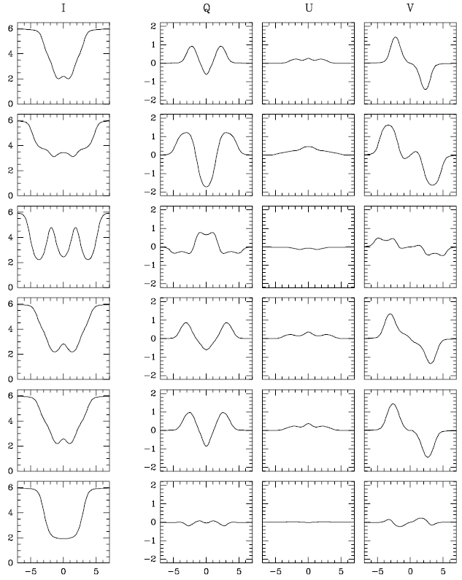
The Milne-Eddington approximation is broadly used
¹S₀-¹P₁
⁵D₂-⁷D₃
⁵P₁⁻⁵F₁
⁵D₃-⁵F₃
⁵P₃⁻⁵D₄
⁵D₁-⁵G₂

Slide 26
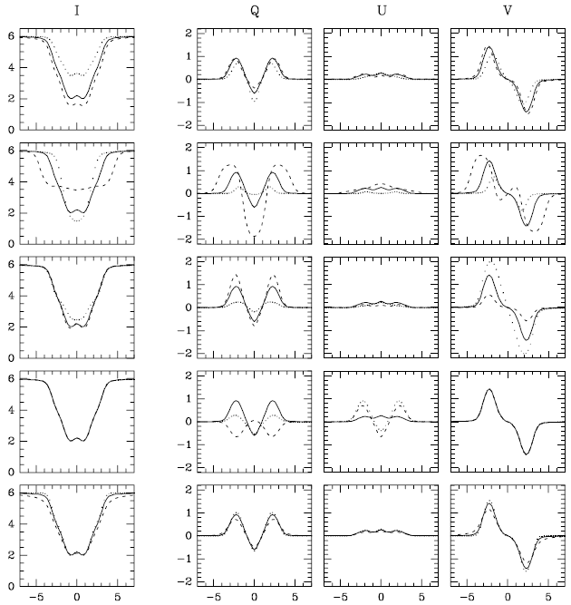
The Milne-Eddington approximation

Slide 27
Zeeman Saturation is correctly captured

Slide 28
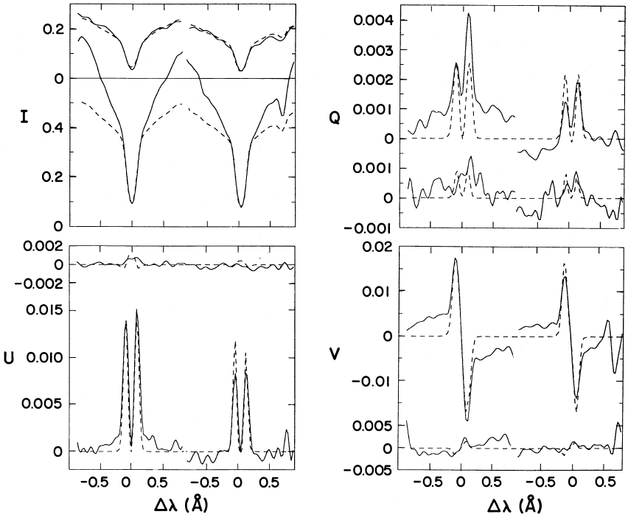
Milne-Eddington with Zeeman effect
Lites et al. (1988)

Slide 29
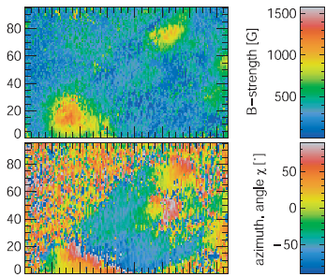
Milne-Eddington with Zeeman effect
Helix →Lagg et al. (2004, 2007)
PB →Socas-Navarro et al. (2005)

Slide 30
Inversion procedure
B, h, v_{th}, v_{mac}, a
Emergent profiles
Observed
Stokes profiles
Statistical estimator (²)
NO
² smaller than
previous?
NO
Convergence?
Propose another
set of parameters
YES
YES
Save parameters
EXIT

Slide 31
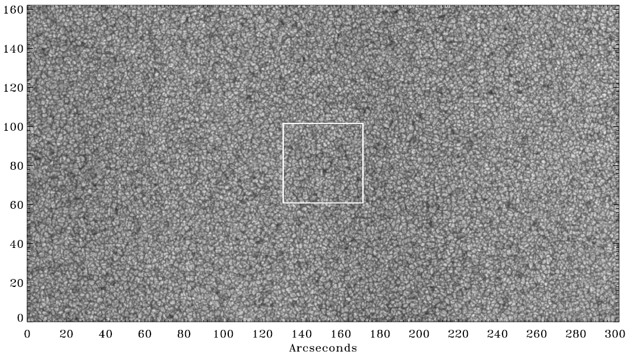
Observations from space - Hinode
Lites et al. (2008)

Slide 32
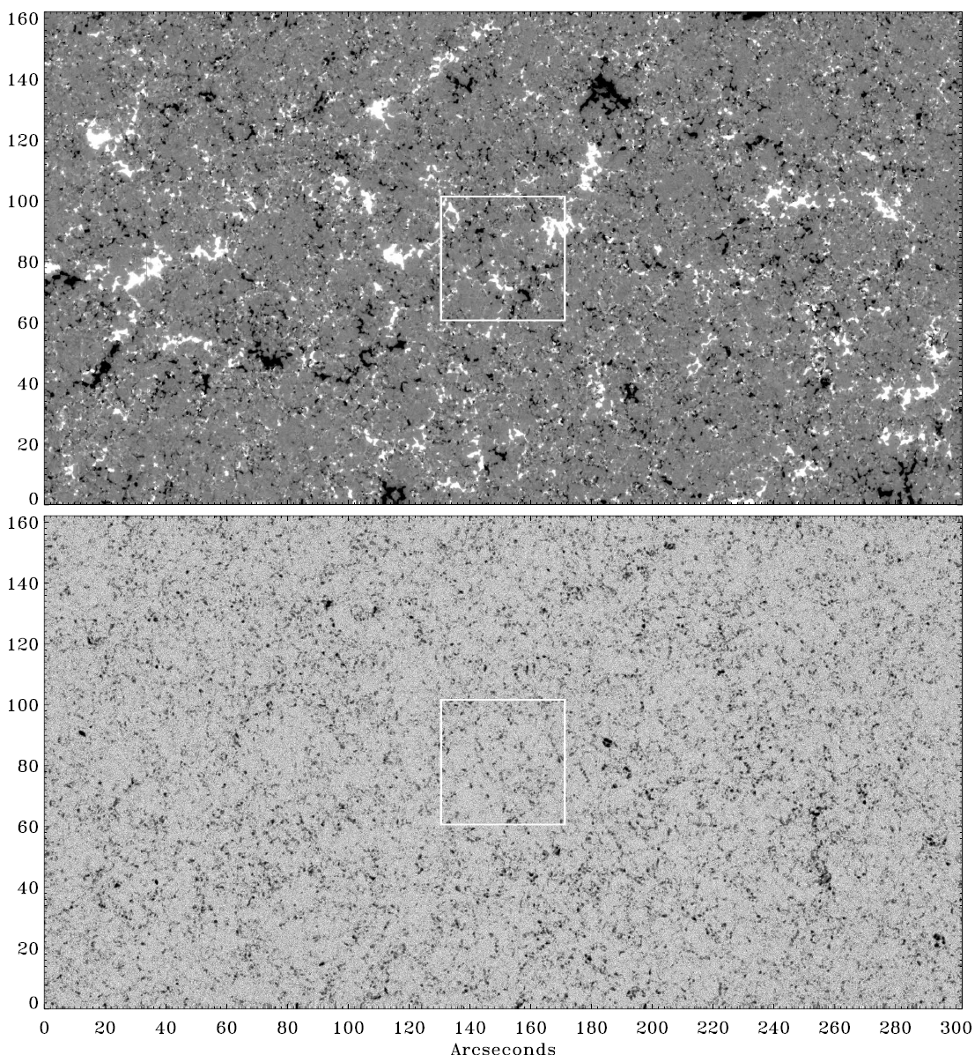
Circular
polarization
Linear
polarization

Slide 33
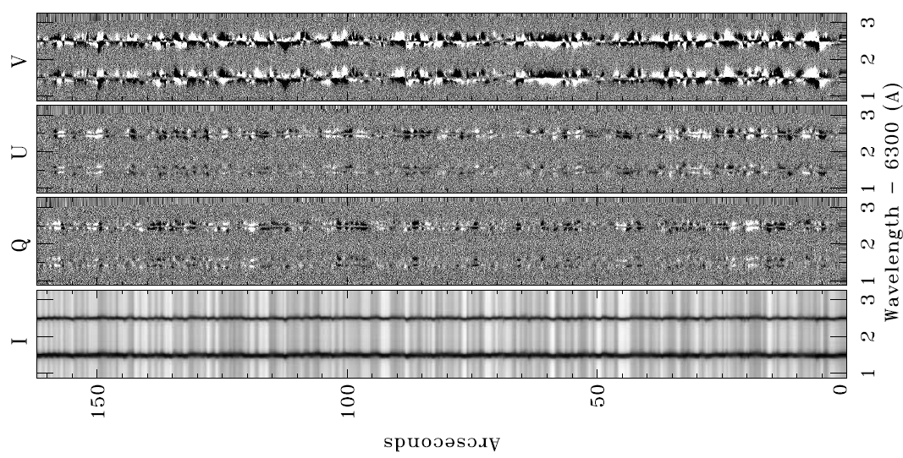
There is signal everywhere

Slide 34
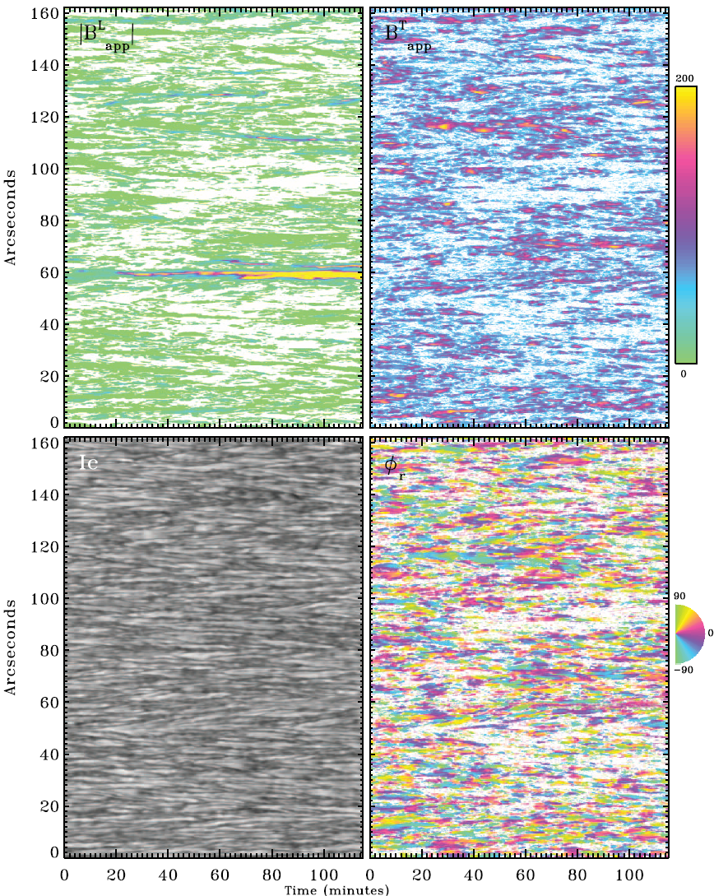
Milne-Eddington inversions give magnetic field properties

Slide 35
Milne-Eddington with Zeeman effect
PROS
Inversion can be made fast
Thermodynamics & magnetic conditions uncoupled (at least verified in photospheric lines)
Some codes are freely available to the community
CONS
Model might be not realistic, specially for pure chromospheric lines or in discontinuous situations (more complex models?)
Errors are sometimes not realistic if ambiguities/degeneracies are present

Slide 36
Gradients along the line-of-sight
Local thermodynamic equilibrium

Slide 37
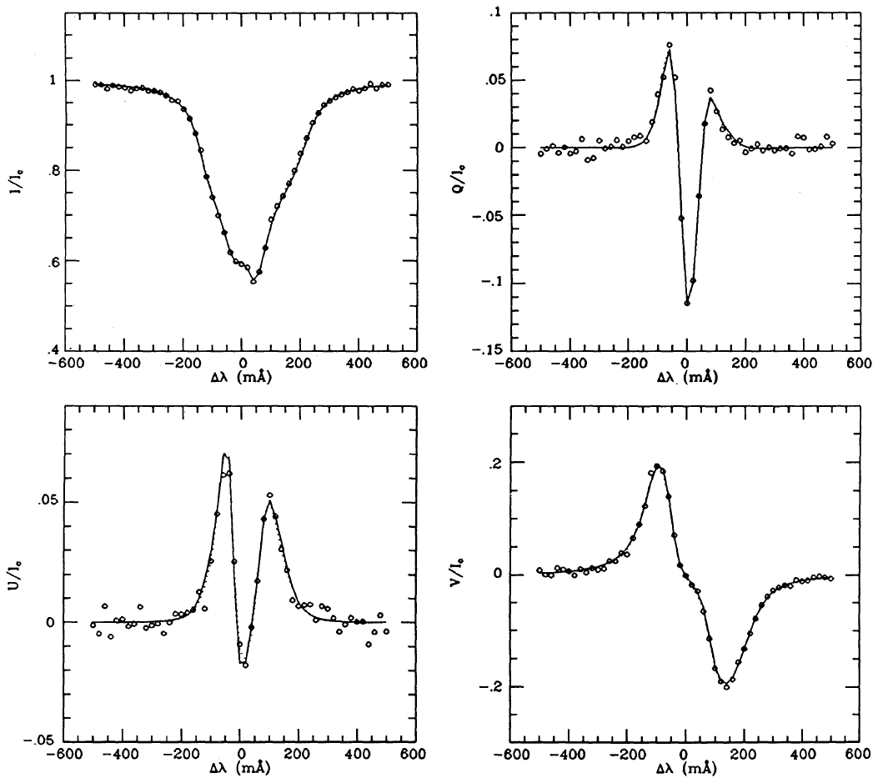
Profiles can be nicely fitted
Ruiz Cobo & del Toro Iniesta (1992)

Slide 38
Inversion procedure (LTE)
B, T, v
Emergent profiles
Observed
Stokes profiles
Statistical estimator (²)
NO
² smaller than
previous?
NO
Convergence?
Propose another
set of parameters
YES
YES
Save parameters
EXIT
Response functions

Slide 39
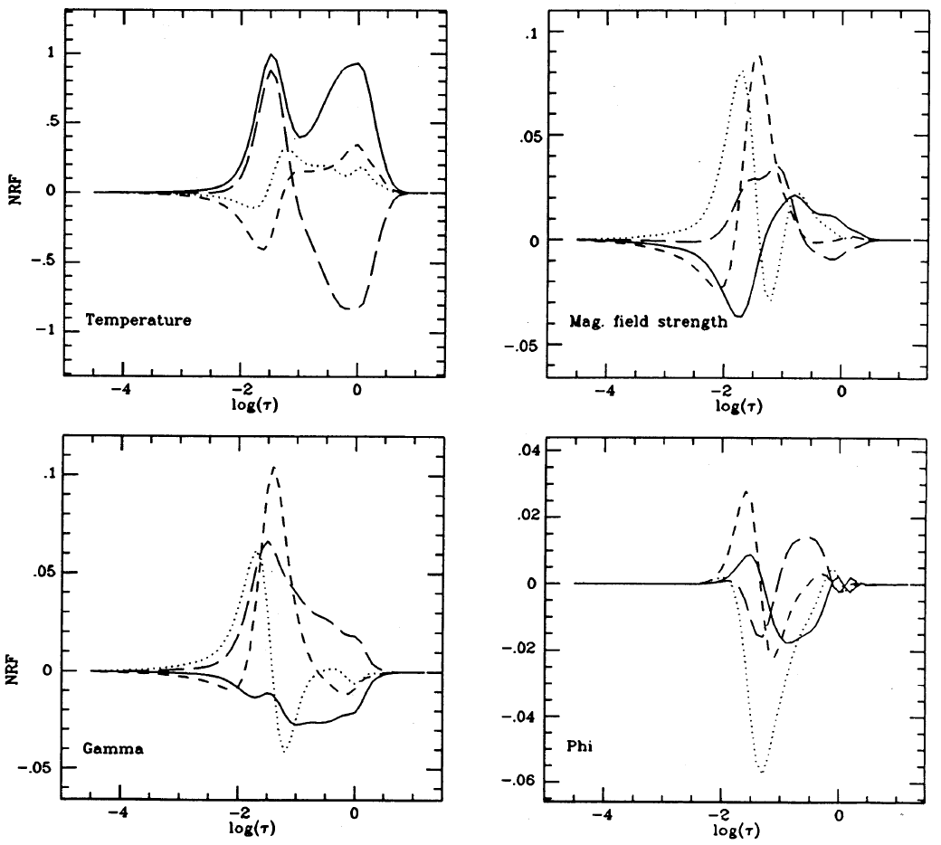
Response functions
Ruiz Cobo & del Toro Iniesta (1992)

Slide 40
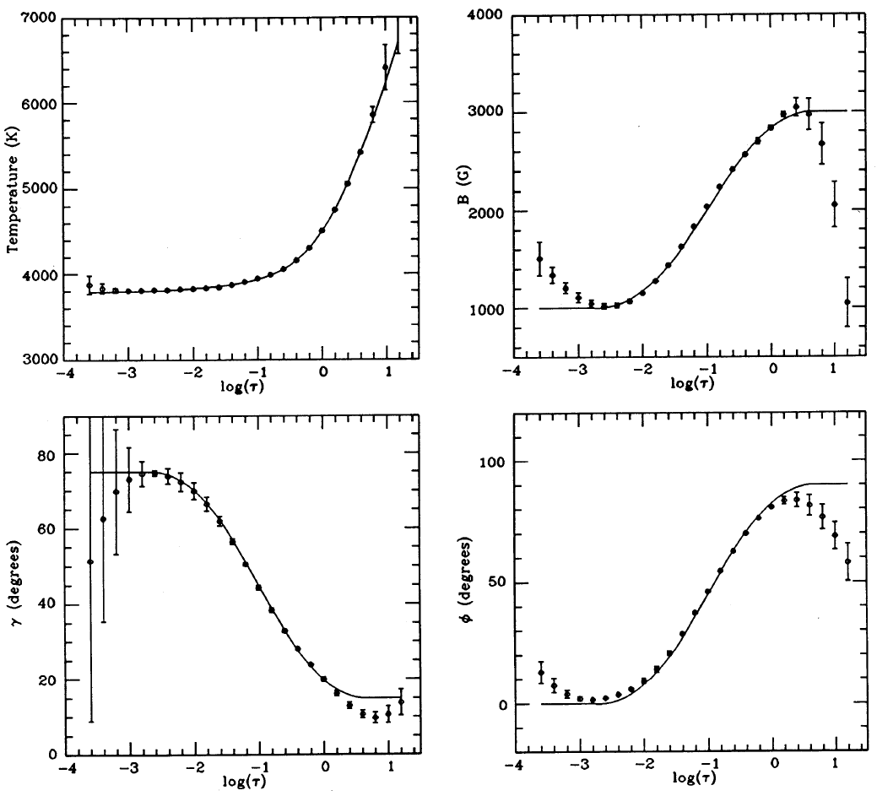
The depth stratification of physical quantities can be obtained
Ruiz Cobo & del Toro Iniesta (1992)

Slide 41
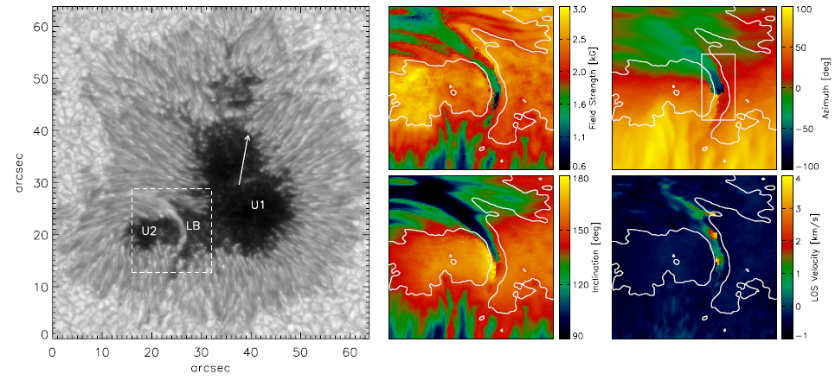
The quality of observations allow to observe fine details
Field strength
Field azimuth
Inclination
LOS velocity
Louis et al. (2009)

Slide 42
Gradients along the line-of-sight
Non-local thermodynamic equilibrium

Slide 43
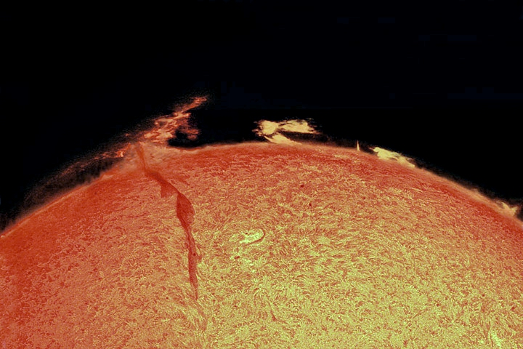
Non-local thermodynamic equilibrium
In NLTE, the source function is unknown and nonlinearly depends
on non-local properties

Slide 44

NLTE: non-local coupling
Radiative transfer equation
Rate equations
Teh Stokes profiles are obtained by self-consistently solving
the two sets of equations → computationally heavy
Rate equations
Radiative transfer

Slide 45
Inversion procedure
B, T, v
Solve SEE
equations
Solve RT equation
Emergent profiles
Observed
Stokes profiles
Statistical estimator (²)
NO
² smaller than
previous?
NO
Convergence?
Propose another
set of parameters
YES
YES
Save parameters
EXIT

Slide 46
Full NLTE with Zeeman effect
Socas-Navarro et al. 2000

Slide 47
Full NLTE with Zeeman effect
Socas-Navarro et al. 2000

Slide 48
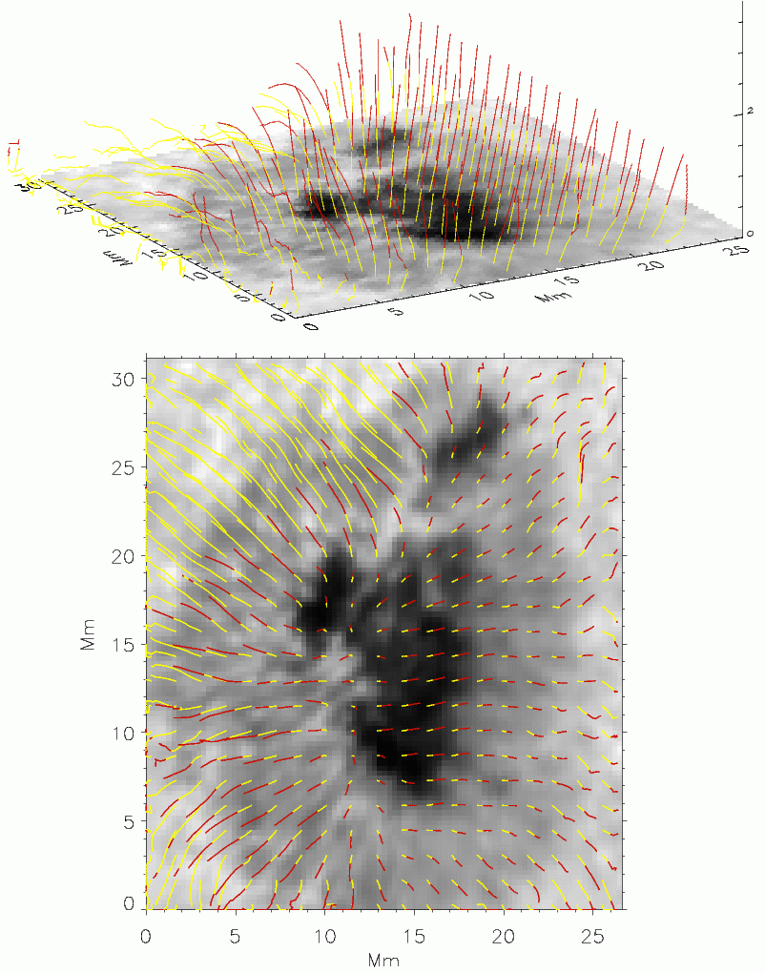
Full NLTE with Zeeman effect
Torsion of field lines with height
Socas-Navarro (2005)

Slide 49
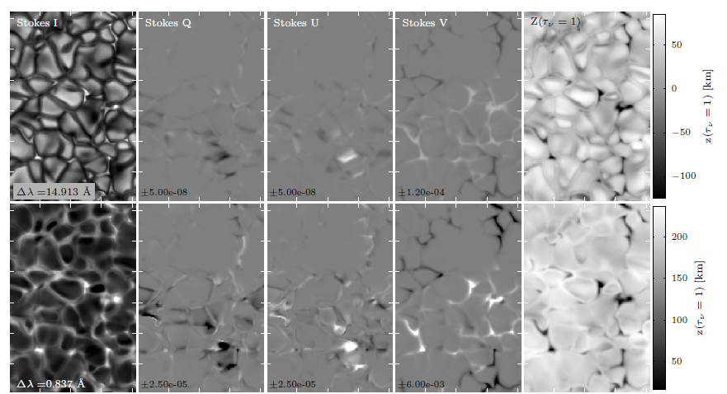
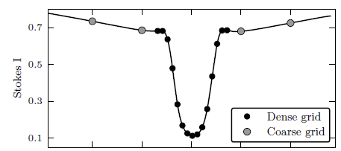
NLTE synthesis with Zeeman effect
de la Cruz Rodríguez et al. (2012)

Slide 50
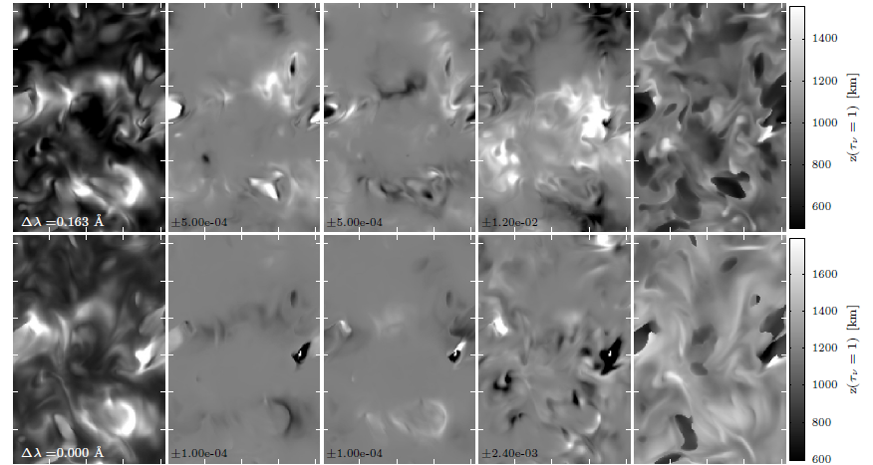
NLTE synthesis with Zeeman effect
de la Cruz Rodríguez et al. (2012)

Slide 51
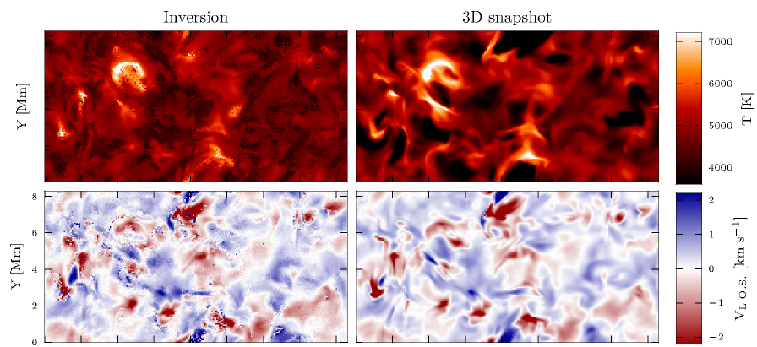
Temperature and velocity can be inferred
de la Cruz Rodríguez et al. (2012)

Slide 52
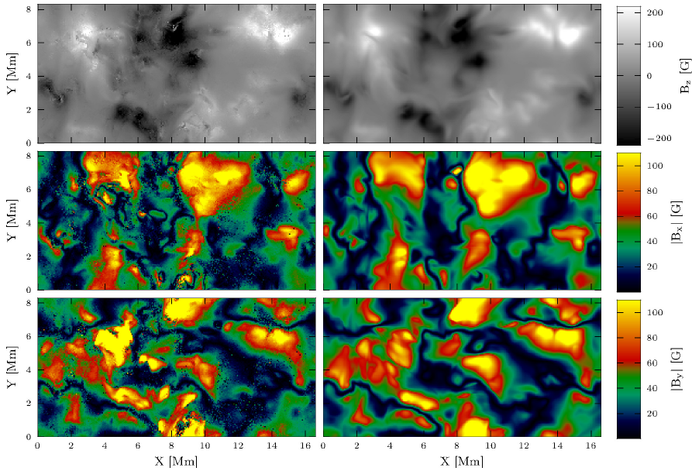
Magnetic field properties can be inferred
de la Cruz Rodríguez et al. (2012)

Slide 53
Do we want very complex models? It depends…
The information encoded on the Stokes profiles is limited and
we have to use models of the appropriate complexity
Although the Stokes profiles dimensionality is potentially R^{N} (with N the
number of wavelengths) they live instead in a manifold of much reduced
dimensionality because of the presence of correlations (physics)

Slide 54
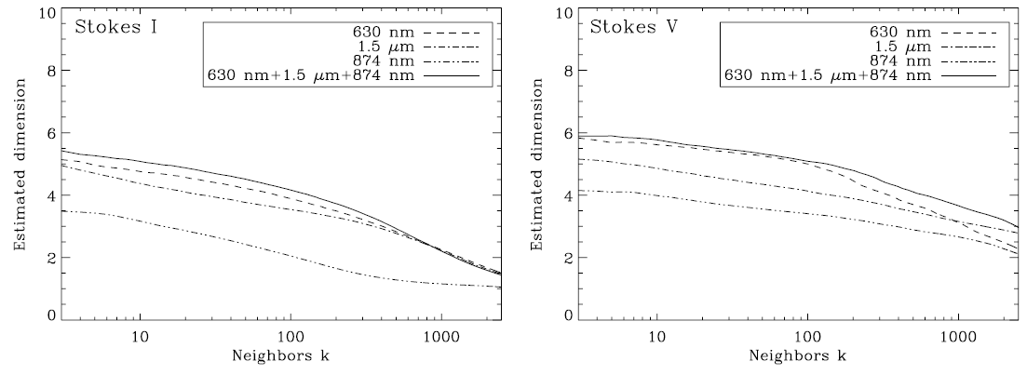
Observations set the maximum complexity
Our model cannot have many more parameters than the intrinsic
dimensionality of the Stokes profiles
Additionally, there are competing models to explain the observations
and we need a quantitative way of choosing among them
Asensio Ramos et al. (2007)

Slide 55
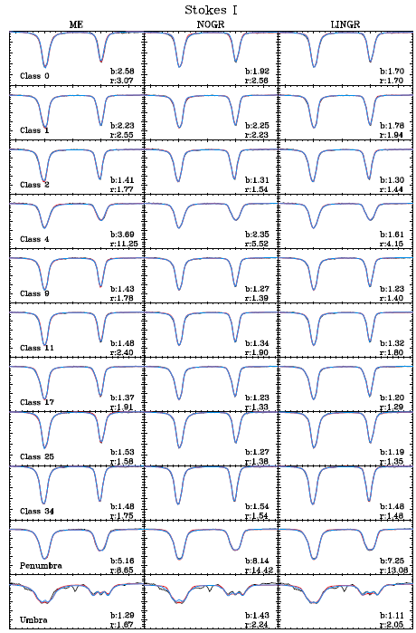
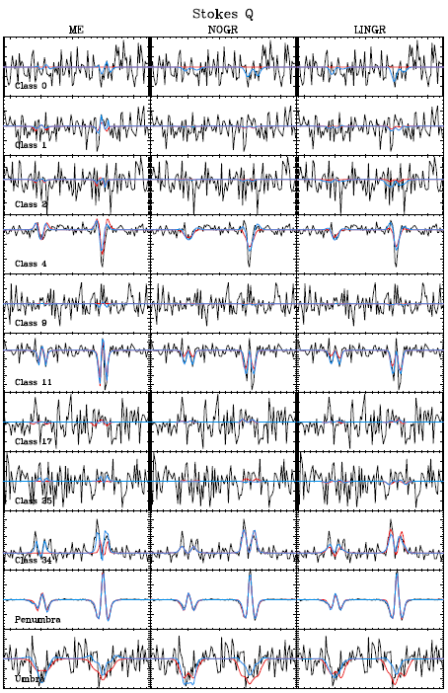

Slide 56
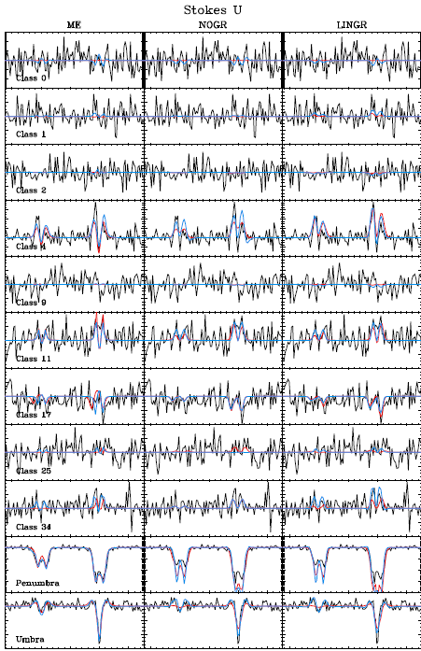
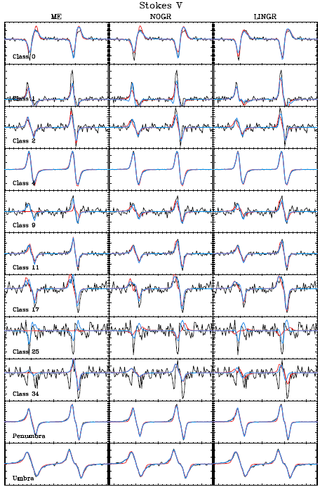

Slide 57
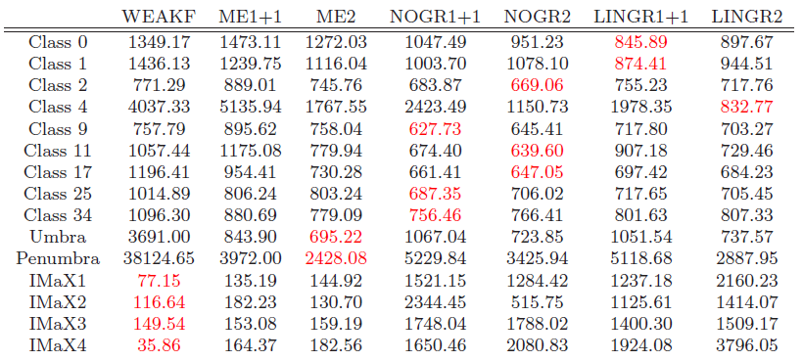
Competing models can be compared using BIC
Select the model giving the smallest BIC
The best model is correctly selected in ~80% of the cases

Slide 58
Available inversion codes
Helix (Lagg et al. 2004) (MPI)
Melanie (Socas-Navarro)
VFISV (Borrero et al. 2007) (Very fast-HMI)
MERLIN (Lites et al. 2007) (Hinode)
MILOS (Orozco Suárez et al. 2007)
Zeeman Milne-Eddington
SIR (Ruiz Cobo & del Toro Iniesta 1992)
Nicole (Socas-Navarro et al. 2000) (MPI)
Zeeman full LTE/NLTE inversion
Hazel (Asensio Ramos et al. 2008) (MPI)
Helix+ (Lagg et al. 2009) (MPI)
Zeeman+scattering

Slide 59
Fast inversion schemes

Slide 60
Generation of databases can be an option
Modern telescope are generating and will generate huge amounts of data
Standard non-linear inversion are too computationally demanding (an option is to build specific hardware like the FPGA inversor of SO/PHI)
Fortunately, Stokes profiles of parametric models live only on a low-dimensionality manifold

Slide 61

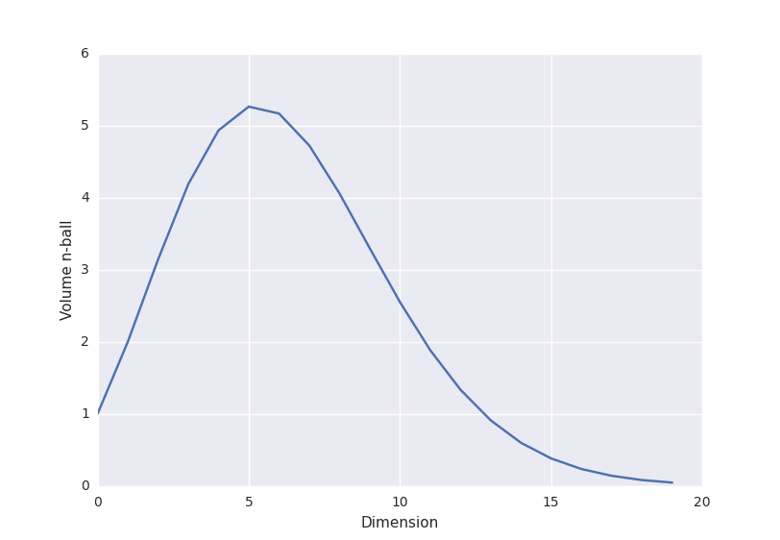
In high dimensions, unit volumes occupy less and less space
If errors are small → every database is always sparse
Volume of the unit hypersphere

Slide 62
Emulators
Synthesizing Stokes profiles takes 10⁻⁴ - 1 seconds
3 hours of 2000x2000 pixels at a cadence of 1 min

Slide 63
Look-up table (diagram)
B, T, v
Solve SEE
equations
Solve RT equation
Emergent profiles
Large database

Slide 64
Look-up table (diagram)
B, T, v
Solve SEE
equations
Solve RT equation
Emergent profiles
Compressed
database
Large database
Observed
Stokes profiles
Statistical estimator (²)
Best model

Slide 65
Look-up table inversion
Themis code (López Ariste)
ANN (Socas-Navarro)
Zeeman Milne-Eddington
Zeeman+scattering
He I 10830+D3
(Casini, López Ariste & Paletou)

Slide 66
Multiline look-up inversion
Multiline inversions
He I D3+10830 Å
Database of 250000 models
for errors of ~10⁻³
Size of DB for smaller errors?
Are they practical?
Interpolation?
Casini et al. (2009)

Slide 67
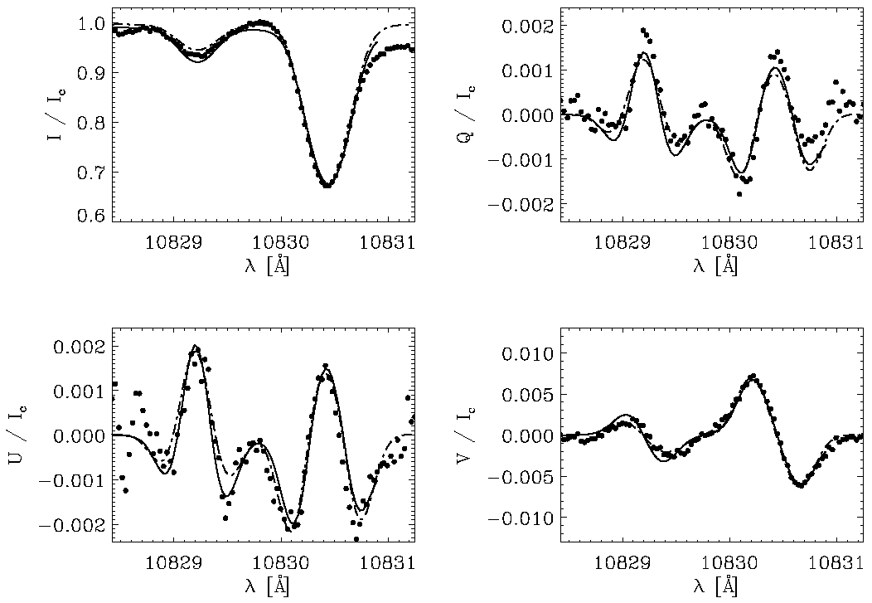
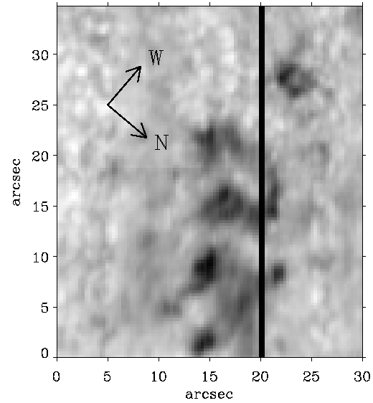
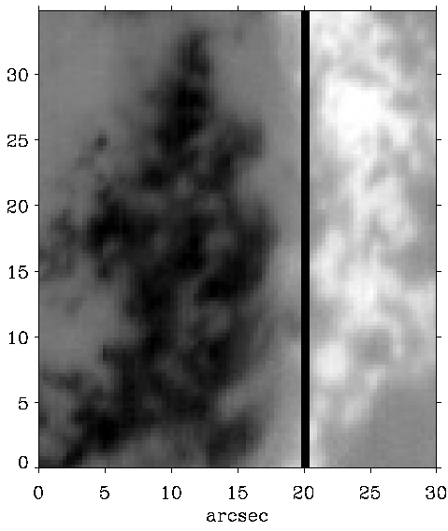
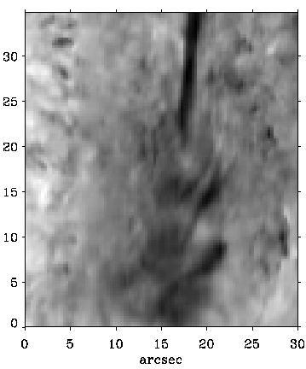
Look-up inversions for 10830 Å
B=626 G
θ=80º
Very large fields in
AR filaments
Kuckein et al. (2009)

Slide 68
Solar prominences (look-up inversion)
Casini et al. (2005)

Slide 69
Inversion procedure (Look-up)
PROS
Inversion is fast → computation time depends on the size of the DB
Realistic error bars can be estimated and ambiguities can be located
A good DB opens up the possibility of doing Bayesian computations
CONS
Databases have to be adapted to the problem
Large databases are needed when noise is small for full coverage
Can miss ambiguities

Slide 70
Look-up tables – Learning the manifold with SOM
Temperature
Optical depth
Velocity

Slide 71
Look-up tables – Outlook
Practically unavoidable for quick inversion of Stokes profiles → build databases for many observing conditions
Some interpolation techniques needed to avoid enormous DB
Artificial neural network (global)
Polynomial (local)
…
Investigate non-linear manifold learning
Physics can be “discovered” from them
Investigate efficient generation of databases

Slide 72
The most advanced inversion codes
Pixel-by-pixel inversion
No spatial correlation is used at all
Noise induces degeneracies
Your inversion code is surely biased (and you don’t know it)
We know many things from our solution
Include a-priori knowledge + 2D inversions
Maximum-likelihood → maximum a-posteriori

Slide 73
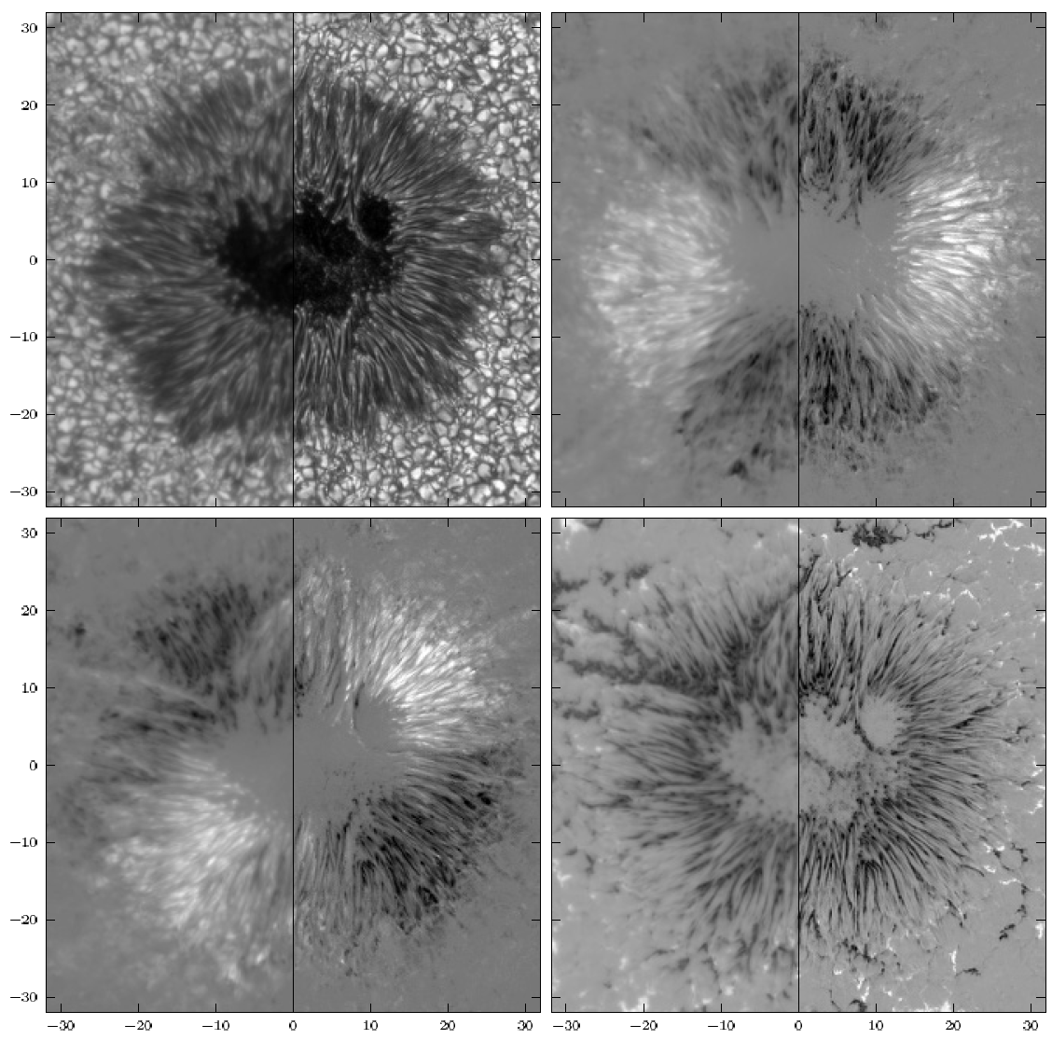
Spatially coupled inversions
If you know the PSF of your instrument, you can include the
convolution in the generative process and deconvolve while inverting
Correct treatment of stray-light
van Noort (2012)

Slide 74
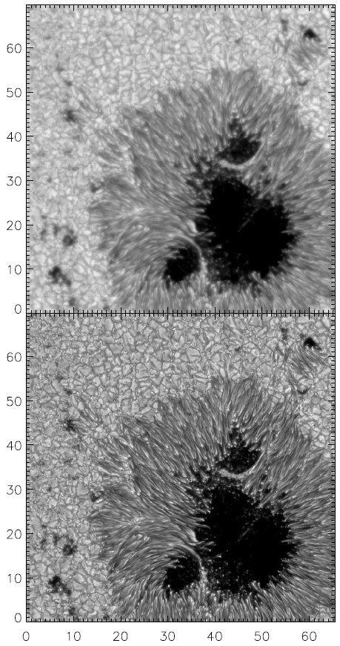
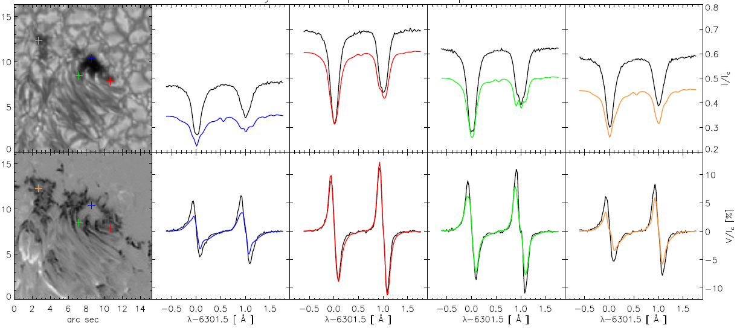
Deconvolution
You can also deconvolve the data first (by introducing regularization)
and then do the standard inversion
Quintero Noda, Asensio Ramos & Ruiz Cobo (2015)

Slide 75
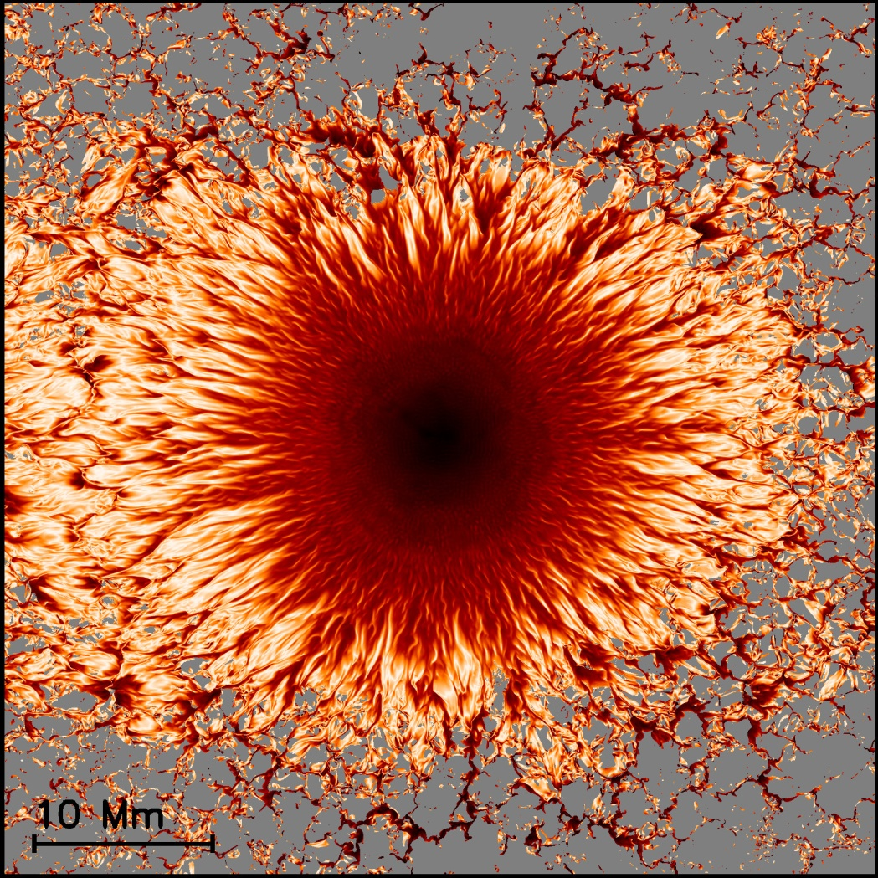
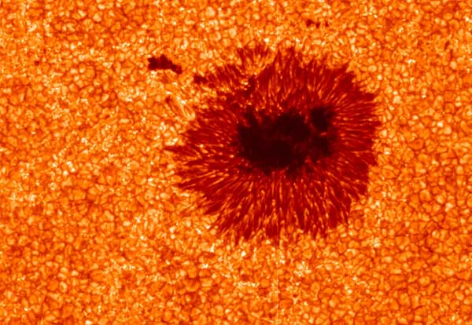
Sparsity regularization
The most recent approach is to carry out 2D inversions taking into
account the spatial correlation present in the data
Spatial correlation is always present – even without any physical reason

Slide 76
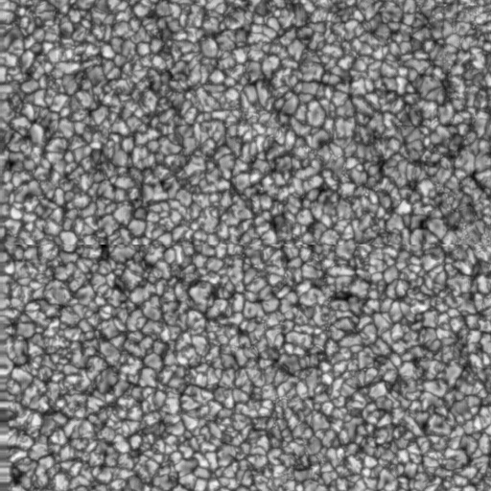

Use compression!
1 MB (RAW)
129 kB (JPEG) - lossy
286 kB (PNG) - lossless

Slide 77
Redundancy
N_{unknowns}=N_{pixel} x N_{parameters}
~10⁷
1000 x 1000
~10-20
Redundant information!

Slide 78
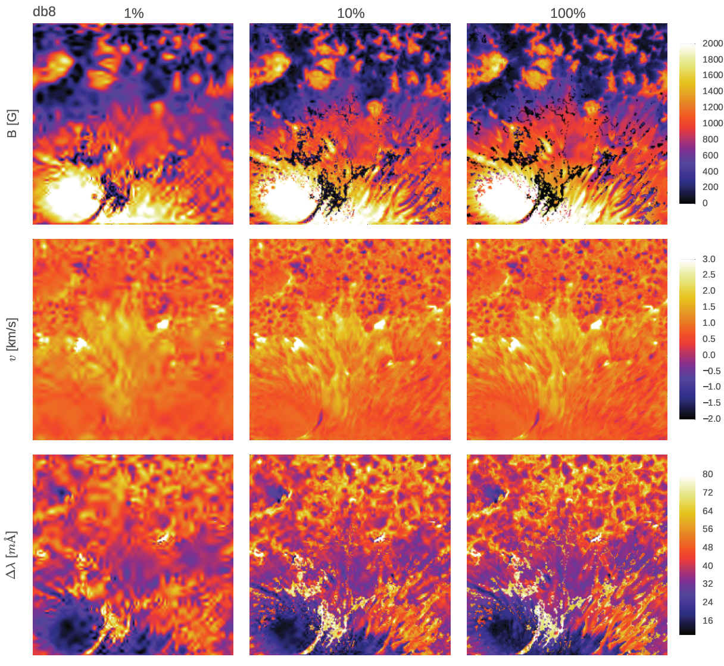
Compression of physical parameters
Asensio Ramos & de la Cruz Rodríguez (2015)

Slide 79
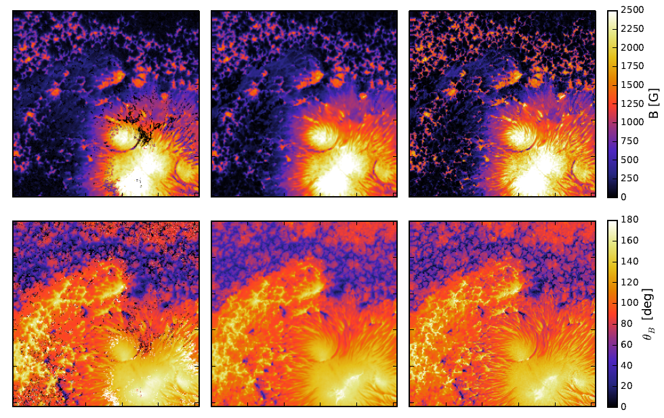
Inversion + deconvolution
Asensio Ramos & de la Cruz Rodríguez (2015)

Slide 80
Stellar magnetic fields

Slide 81

Magnetic fields in stars
Left-hand
Left-hand
Babcock (1947)

Slide 82

Polarization can be used to estimate m.f. in stars
Kochukov & Wade (2010)

Slide 83
Multiline techniques. Improving signal-to-noise ratio
In solar-type stars, the polarization signal per line is very weak because:
Magnetic configuration is complex and leads to cancellation
Rotational broadening of lines generate weak Zeeman signals
…
Semel (1989), Semel & Li (1996) and, later, Donati et al. (1997) and
Martínez González et al. (2008) developed multiline techniques do
enhance the probability of detection
The essential idea is that:
Noise adds up in an uncorrelated way
Real polarization signal adds up in a correlated way (the S/N typically enhances as N^{1/2}

Slide 84



All techniques are essentially ‘line addition’
Line addition (Semel 1989)
Improved line addition (Semel 1995)
Least squares deconvolution (LSD; Donati et al. 1997)
Semel et al. (2009)

Slide 85

Detecting polarization with line-addition techniques
Donati et al. (1997)

Slide 86

Zeeman Doppler Imaging. Rotation helps see m.f.
Why do we see Zeeman signal in a magnetic star if the field is
homogeneous on the surface?
Semel (1989)

Slide 87


ZDI – Signal changes with phase
Brown et al. (1991)

Slide 88


ZDI – It works!
Donati et al. (1997)

Slide 89

ZDI – II Peg magnetic field reconstruction

